Slide 1

Defanging the Dog: Attacking Windows Kerberos
Matthew Navarro

Slide 2
General Outline
Review the Kerberos authentication process.
Overview of the Kerberos landscape
Analyze some Kerberos attacks
Create detections with PowerShell

Slide 3
Kerberos Authentication Process

Slide 4
3 Big Key Exchanges
Client <===> Authentication Server (AS)
Client <===> Ticket Granting Server (TGS)
Client <===> Application Server (AP)
Notes:
Important to not here that the KDC has two services running on it. The Authentication Service and the Ticket Granting Server. The Authentication Service is responsible for verifying the client is who they say they are by challenging them to produce their secret key. The Ticket Granting Server is responsible for finding the service that the verified client wants to use.
The Application Sever is the thing we want to use and its job is to check its security settings to see if the client has permission to use its services.

Slide 5
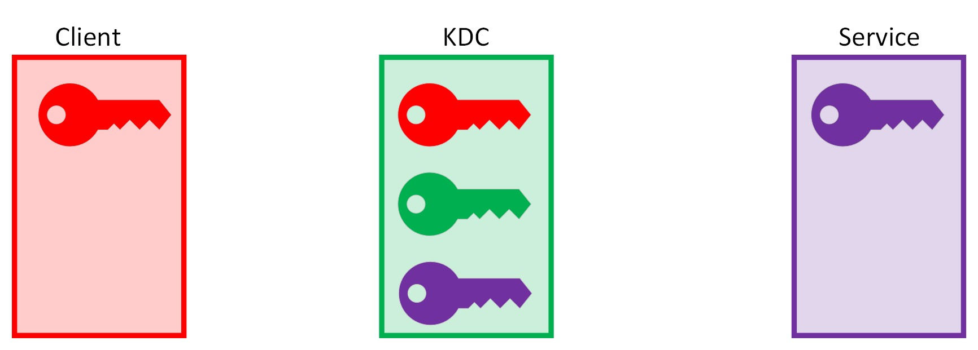
Keys Before Exchanges
Notes:
The KDC is basically your Domain Controller and it has a copy of everyone's keys.

Slide 6
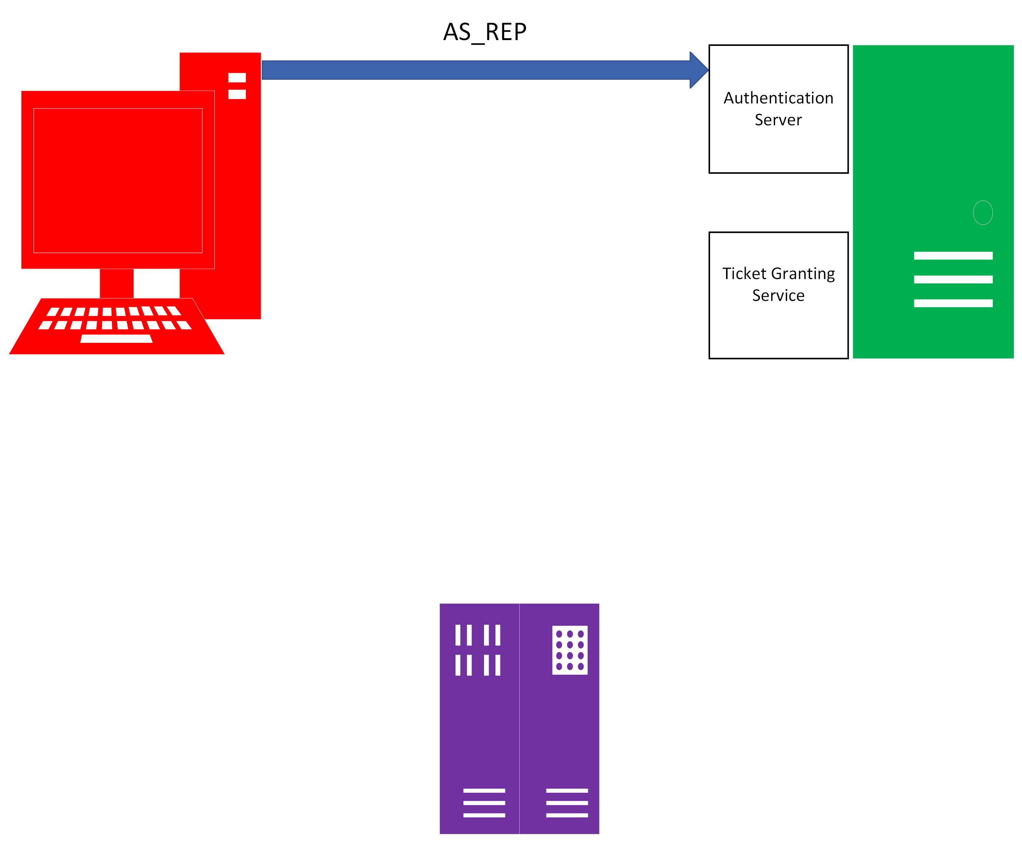
AS Exchange 1
AS_REQ

Slide 7
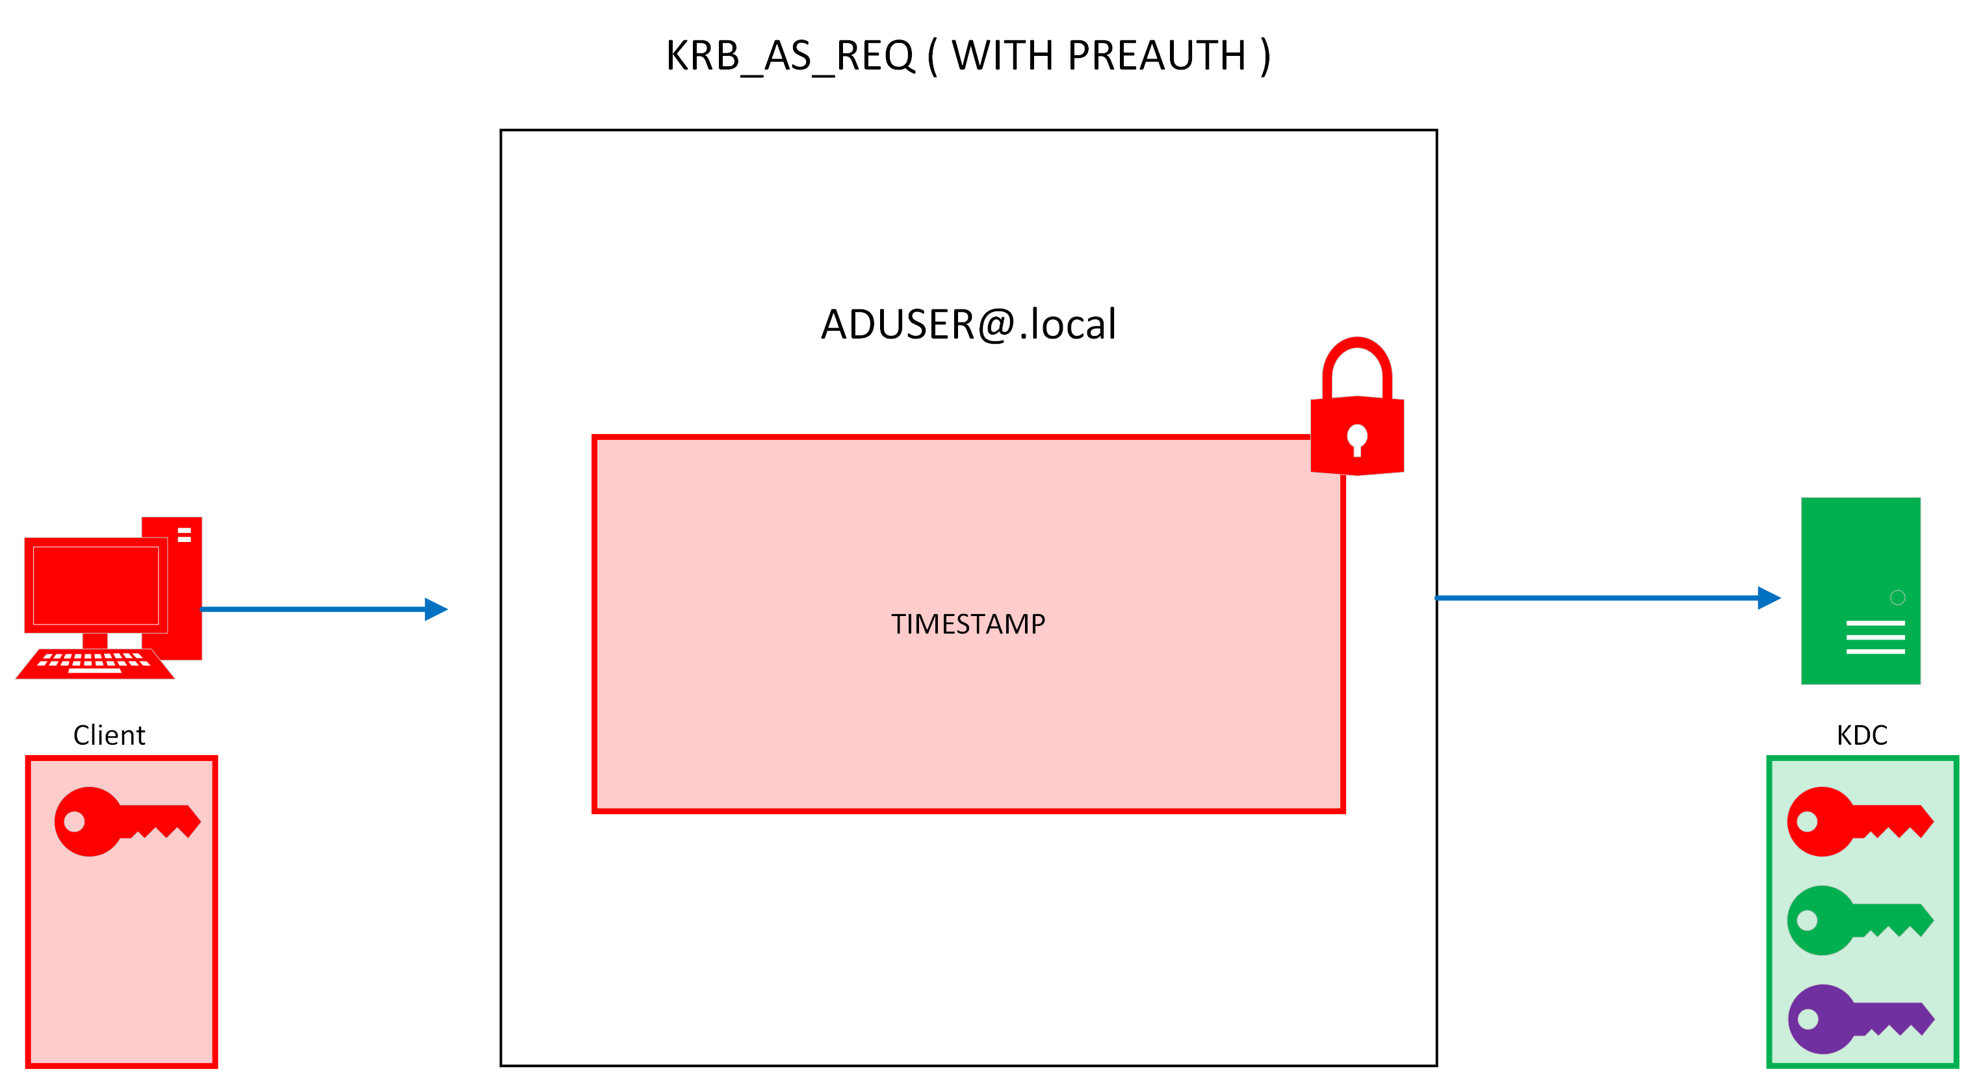
KRB_AS_REQ
Notes:
When you look at a packet inspection, the first AS_REQ does not include a encrypted timestamp. AD is configured by default to required PreAuth, so the first two exchanges here are AS_REQ with no pre auth, a response from the DC ERR_Preauth_required, and then the client responds with PreAuth ( encrypting a timestamp with its password to proof that they are in control of the key)

Slide 8
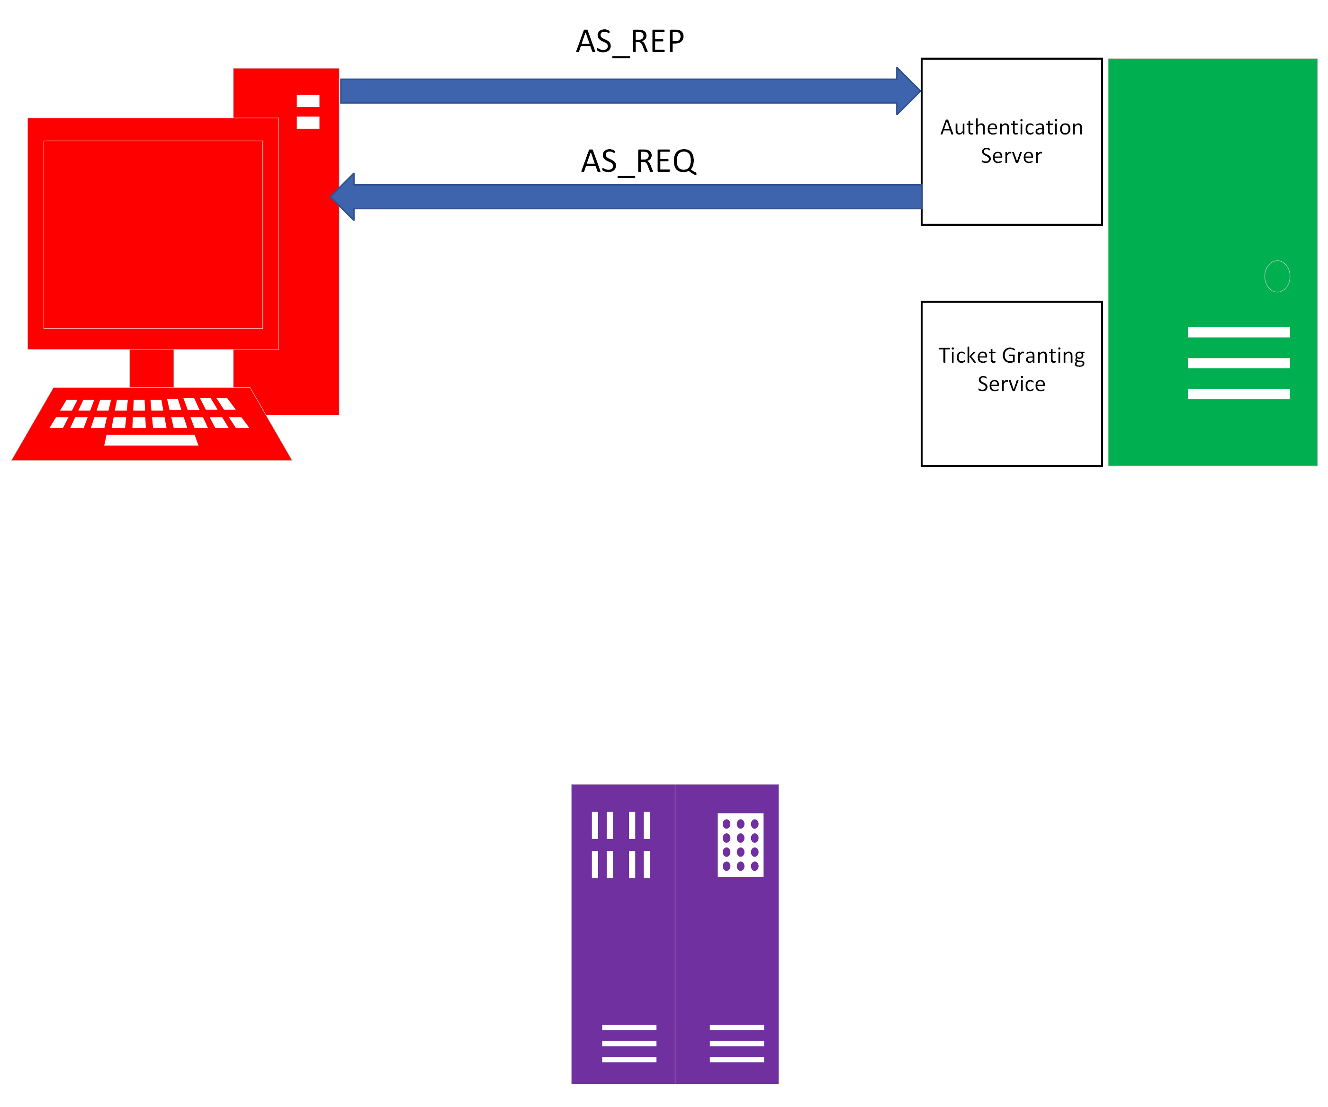
AS Exchange 2
AS_REQ
AS_REP

Slide 9
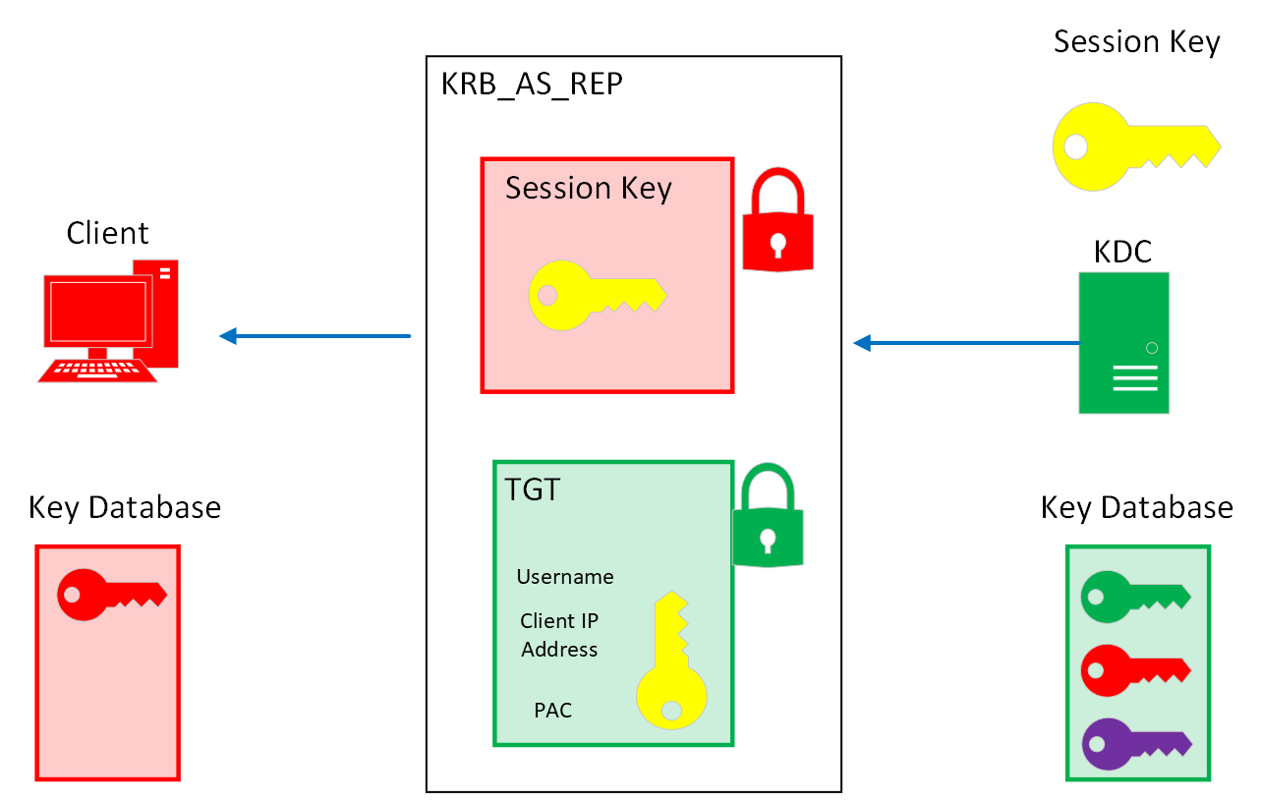
KRB_AS_REP
Notes:
The Authentication Service creates a random session key. It puts a copy in its database and makes 2 duplicates. One for the client to decrypt and keep. The other, in a TGT, which will be sent to the second component in the KDC. This prevents an attacker from trying to create their own session keys and forwarding them to the KDC, in an attempt to impersonate the Client. As an attacker, I may never be able to guess that the key is yellow, and if I do try to forged my own session key and include it the, the Authentication Service will open up my encrypted packet and it extract my forged session key. Then it will open up the TGT and extract the real session key and compare them.

Slide 10
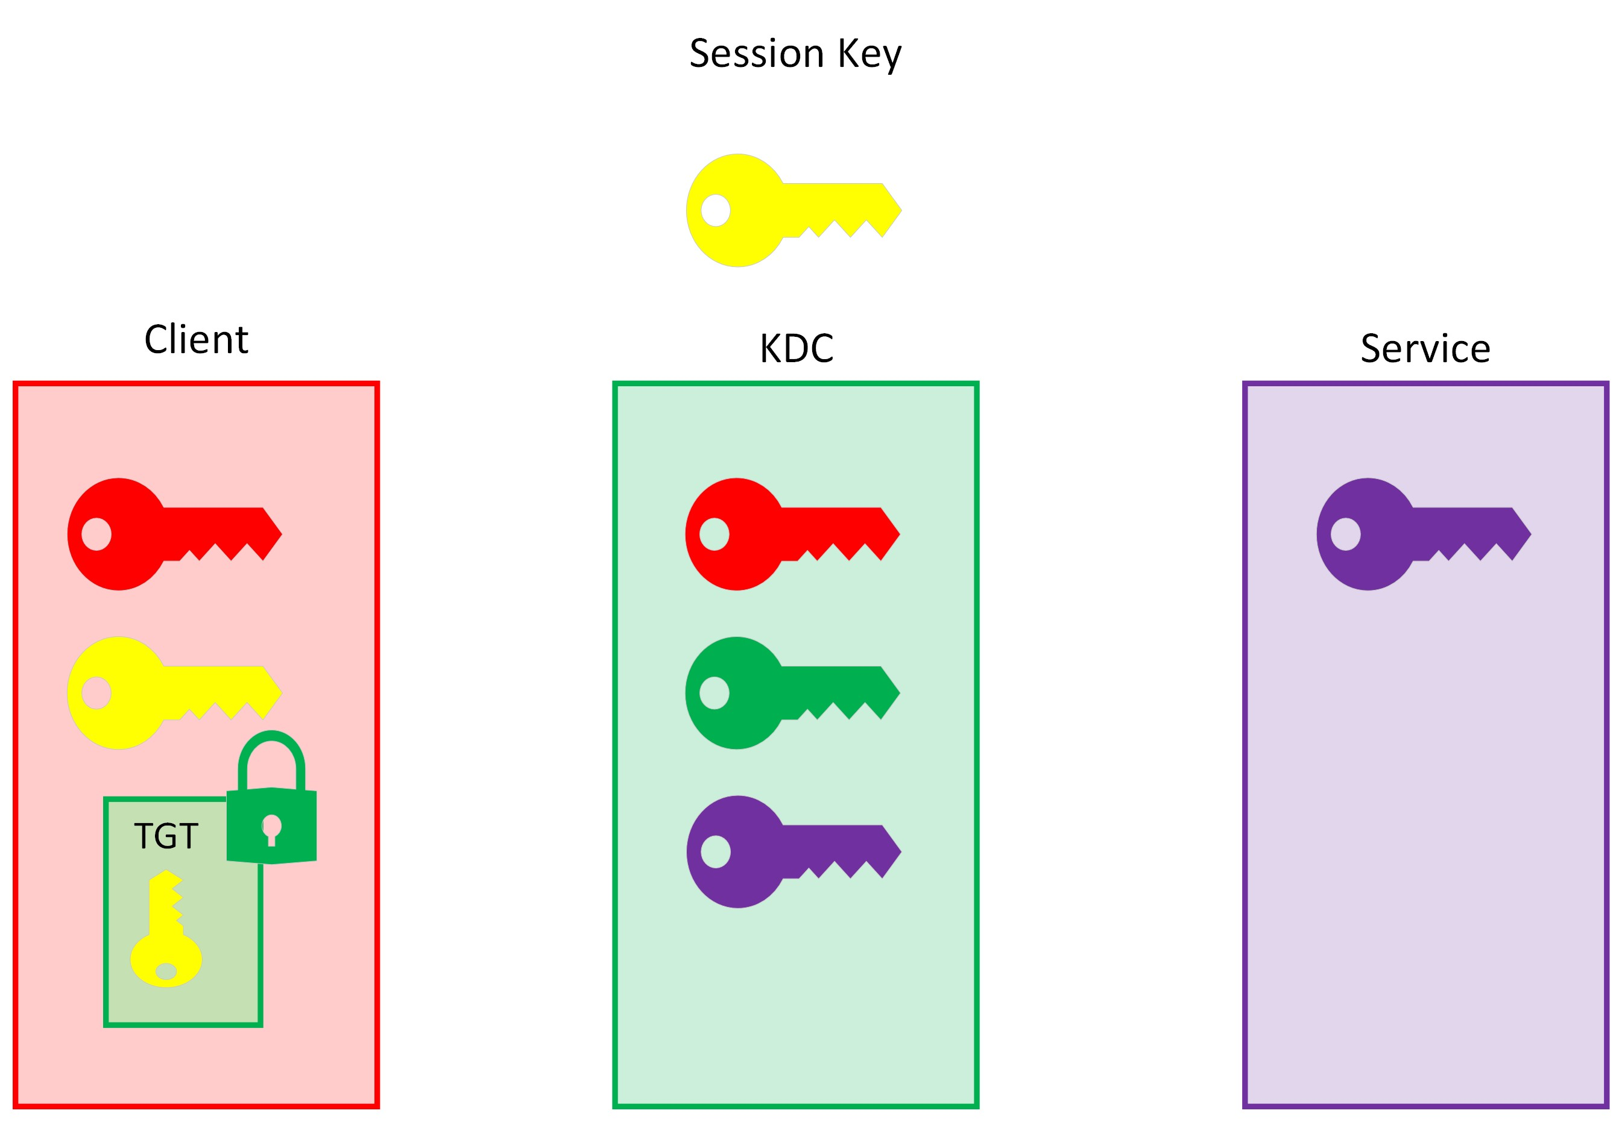
Keys After Authentication Service Exchange
Notes:
A session key has been created. The KDC has the session key in its database and there are two copies out in the network. The client should have both, an unencrypted key and a TGT Ticket that has the second copy safely inside its encryption.

Slide 11
The Authentication Server drops out
Client has been authenticated as a user in the domain.
Client can now begin its request for services.
TGT will be recycled until it expires.

Slide 12
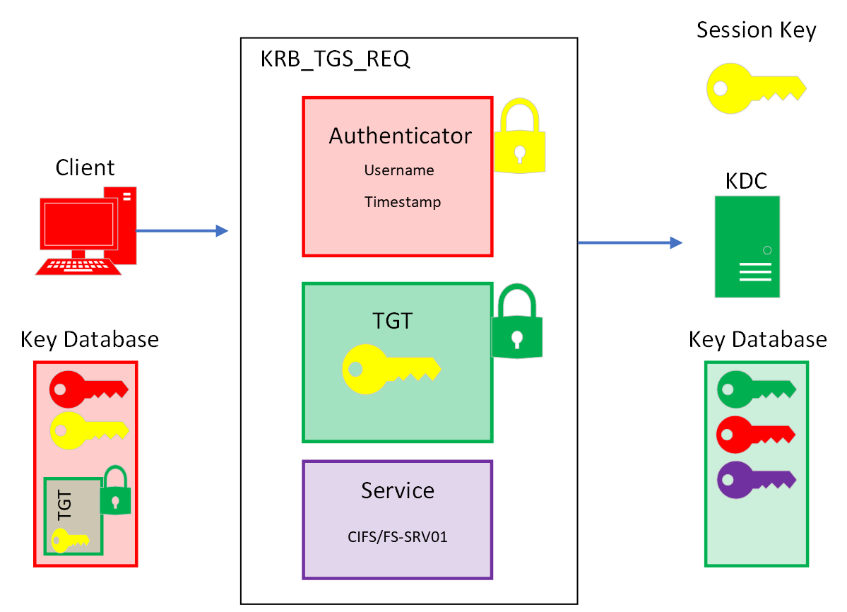
KRB_TGS_REQ
Notes:
The TGS_REQ has three parts
Authenticator
TGT
Service we want to access
The reason why we need to add an authenticator in this packet, is because the if we just depended on the TGT, then a packet sniffer could extract and replay it with the desired service and an attacker would get access, assuming the service allowed us in.
So this is where we finally request the service we want.

Slide 13
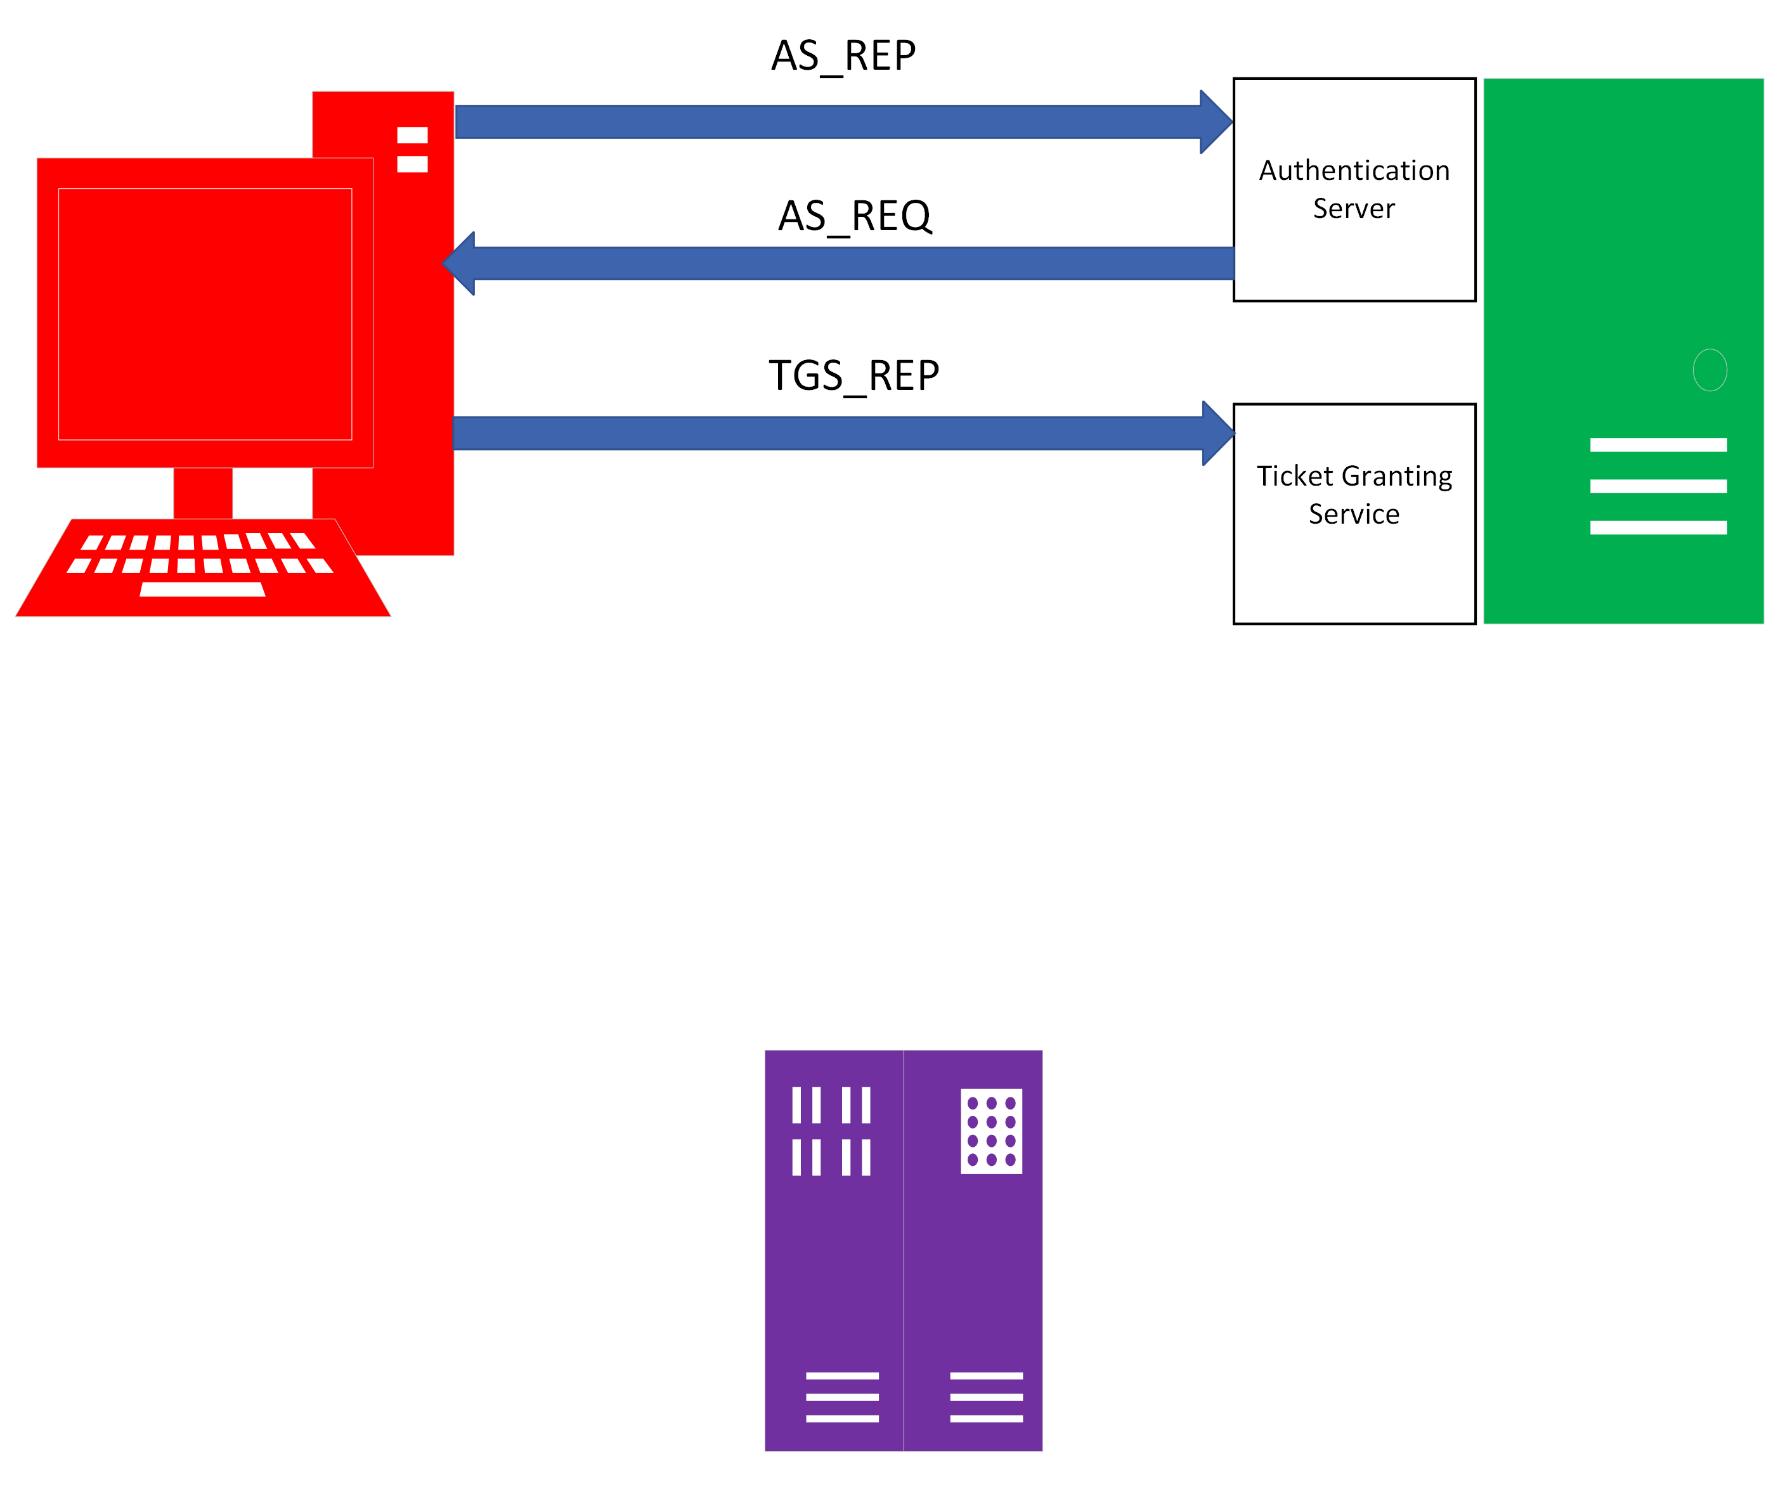
TGS Exchange 1
AS_REQ
AS_REP
Notes:
So again, this is our first communication with the Ticket Granting Server, which is the second component of the KDC

Slide 14
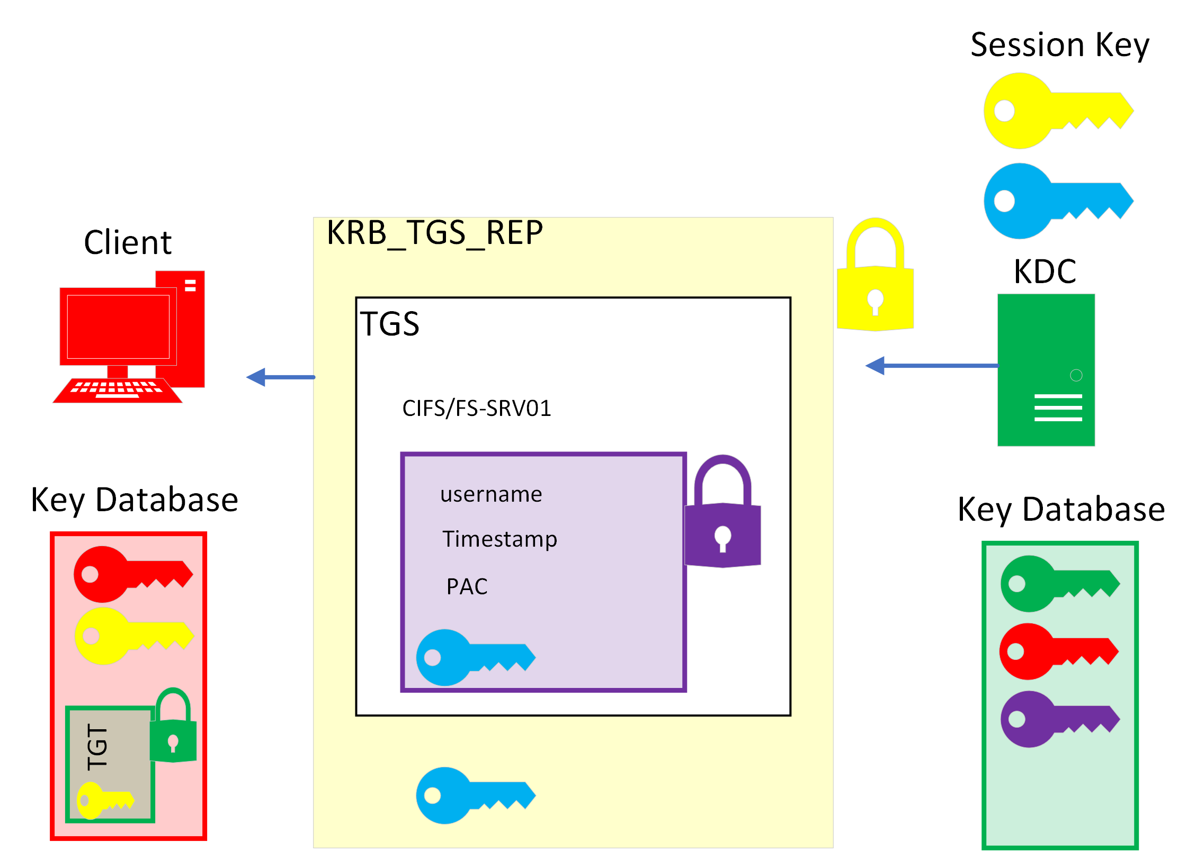
KRB_TGS_REP
Notes:
So we need a second session key to be create here. This session key is going to be used between the client and the server hosting the service.
Because we need a reliable way to transport it, we are going to encrypt it with the session key used between the client and Authentication Server. The design decision to use the sesion key and not the client key is not something I have the answer to.

Slide 15
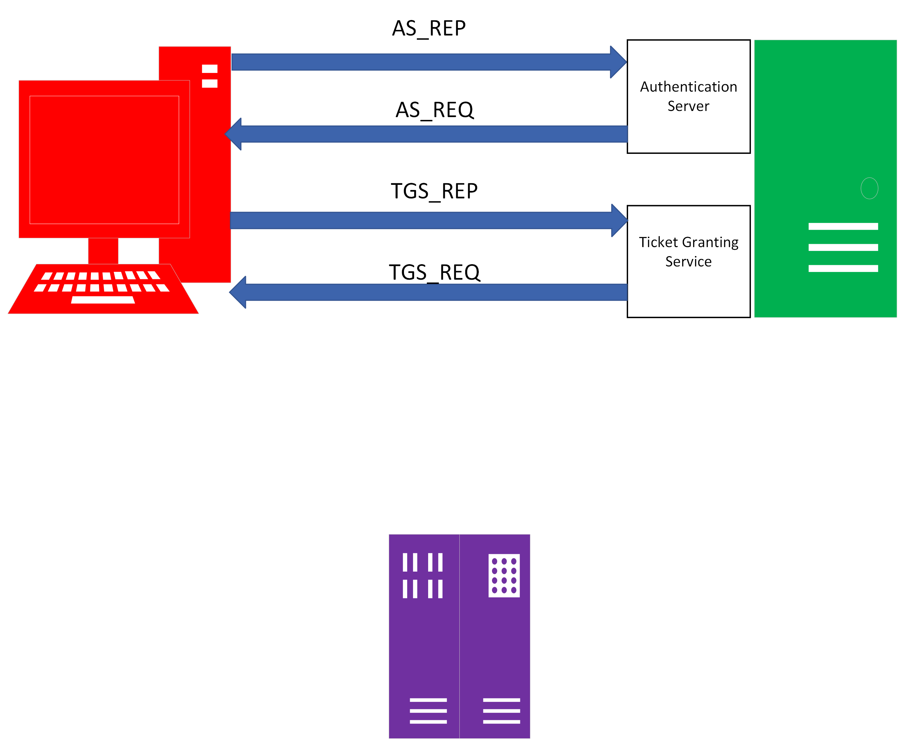
TGS Exchange 2
AS_REQ
AS_REP

Slide 16
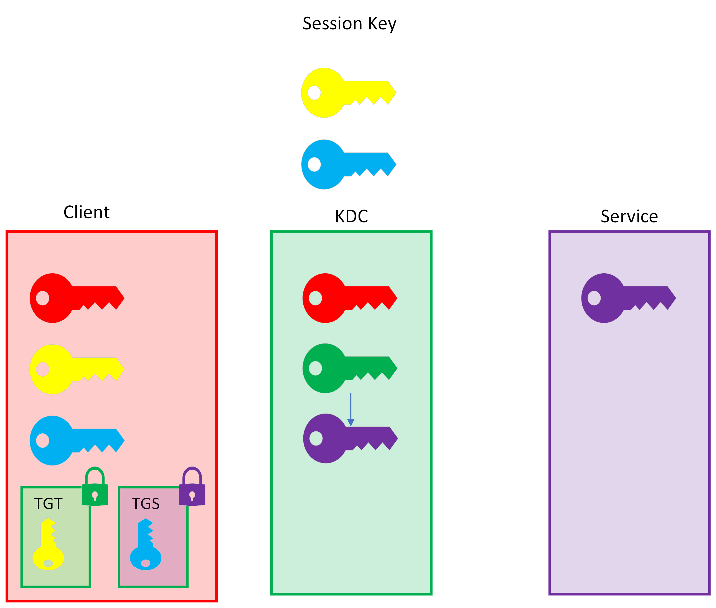
Keys After TGS Exchange
Notes:
So now there are two sessions keys. And we also have two tickets that we cannot decrypt, the TGT and the TGS.

Slide 17
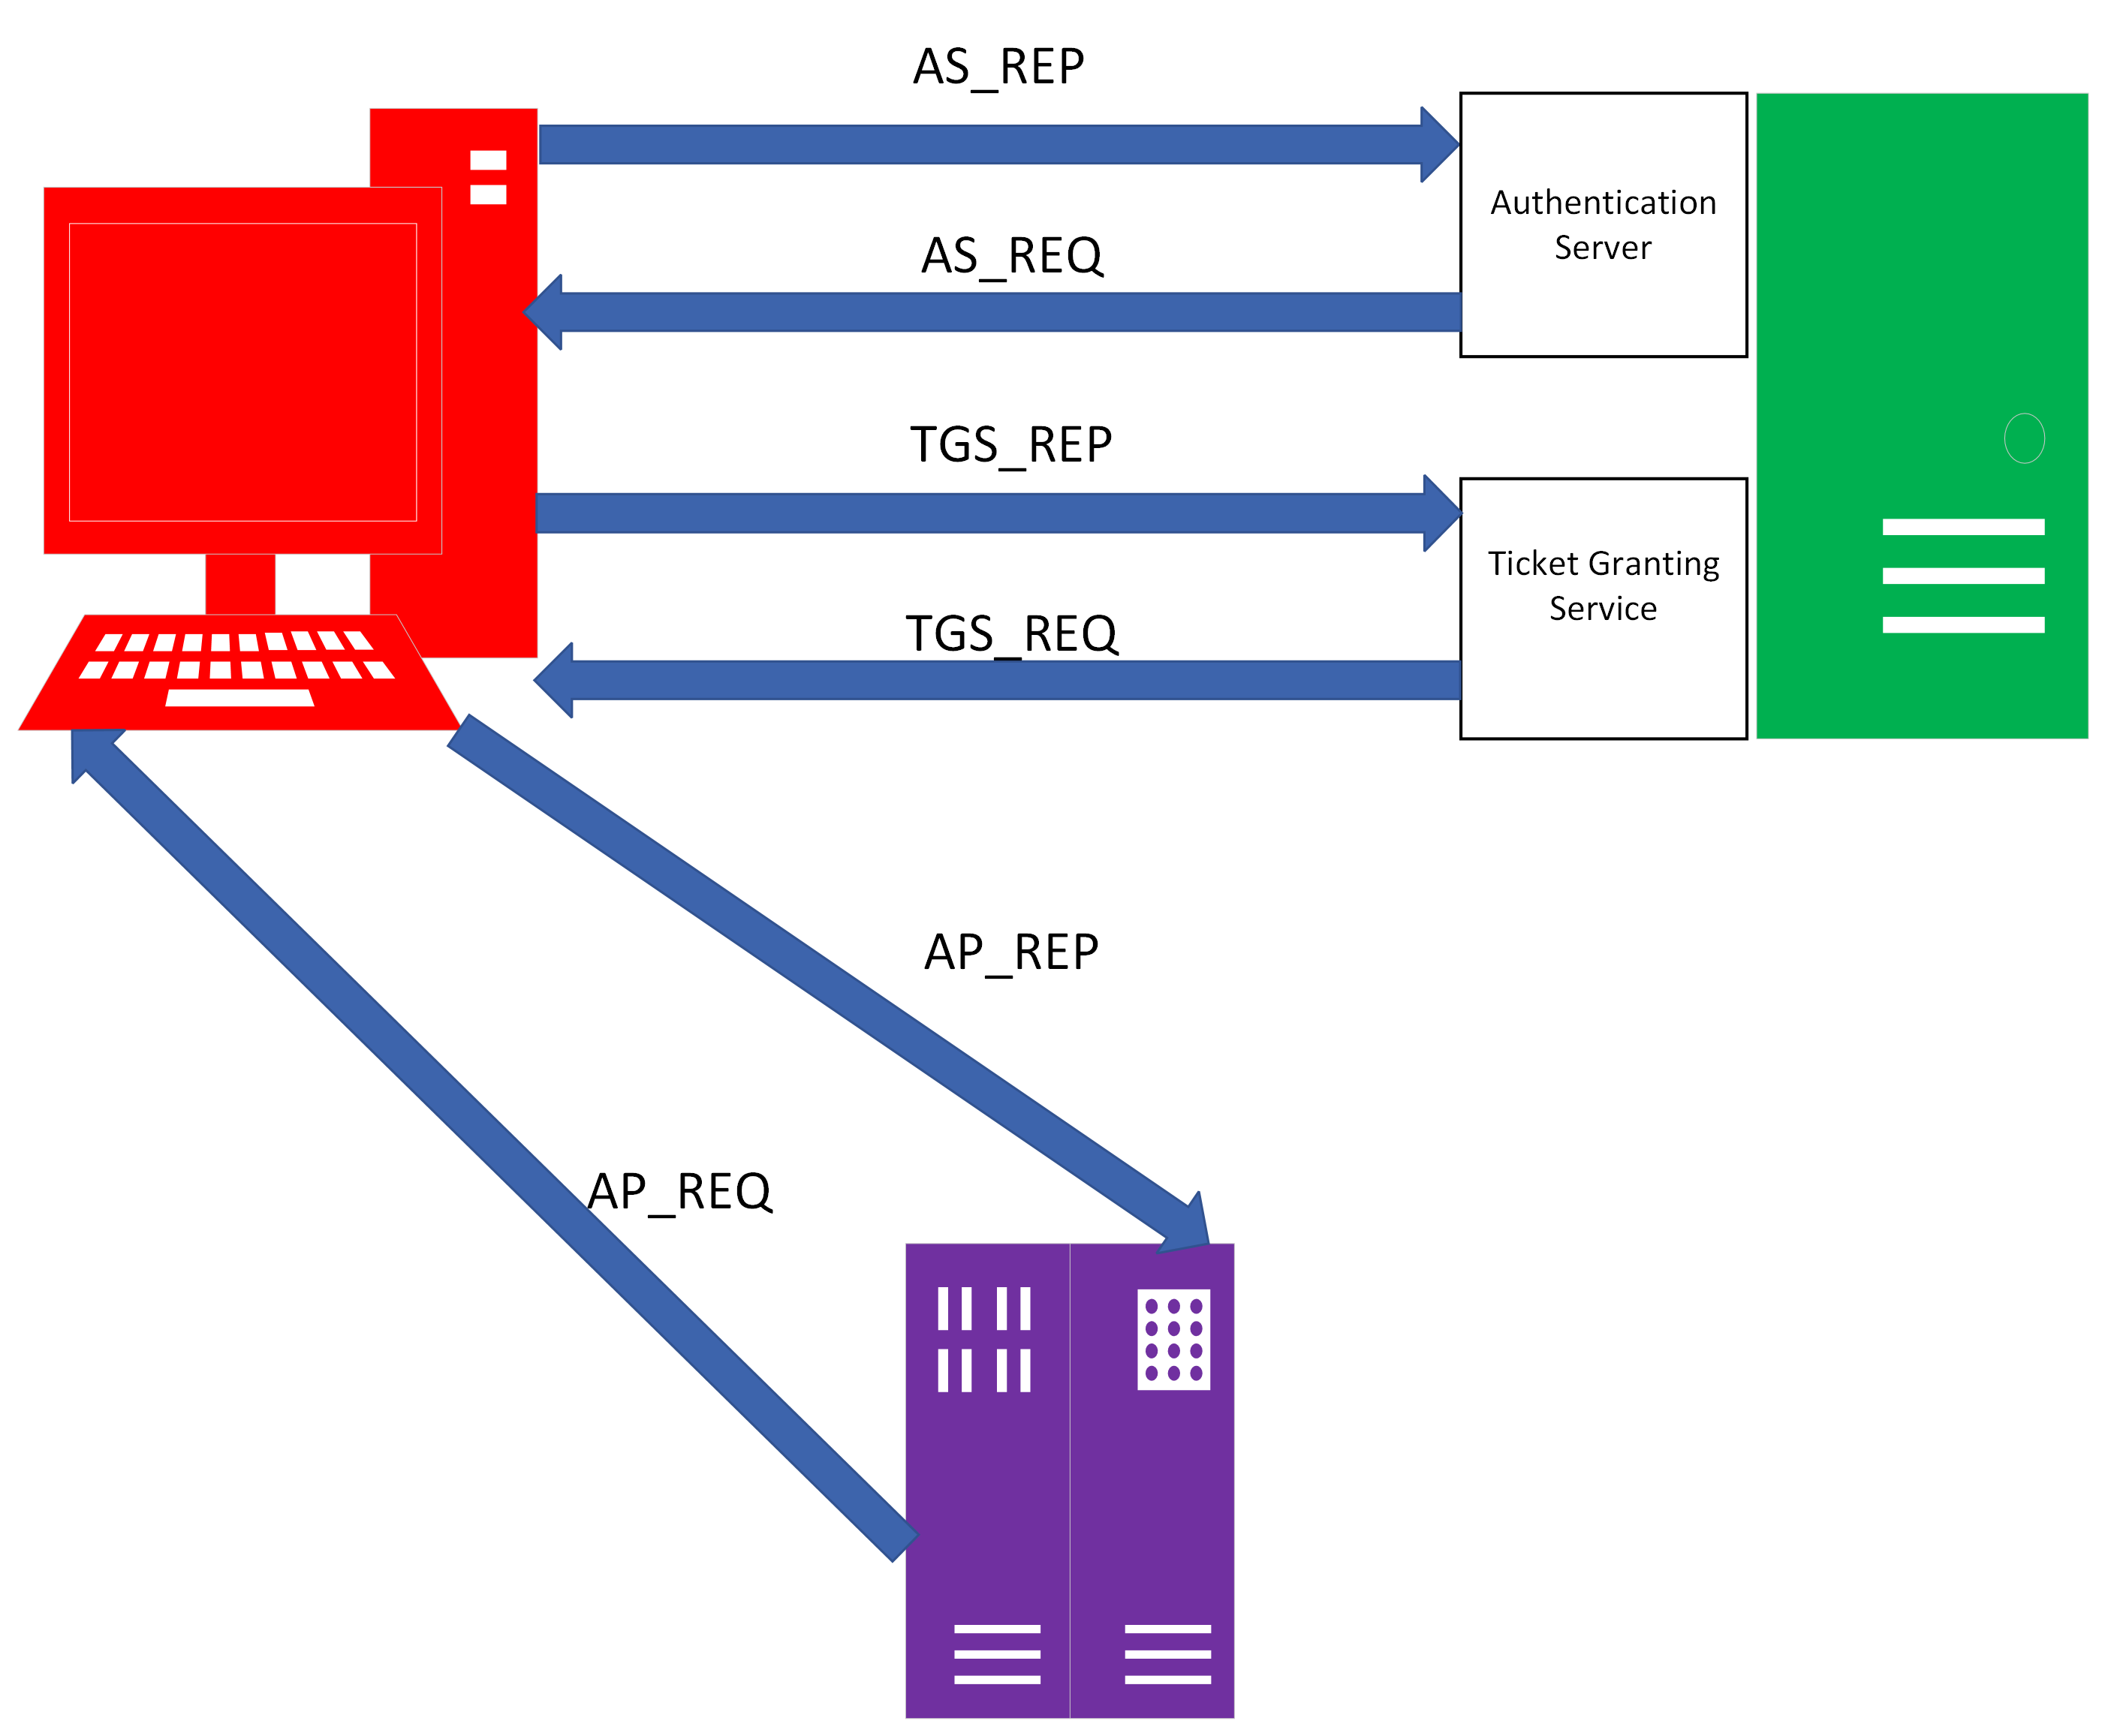
AP Exchange 1
AS_REQ
AS_REP

Slide 18
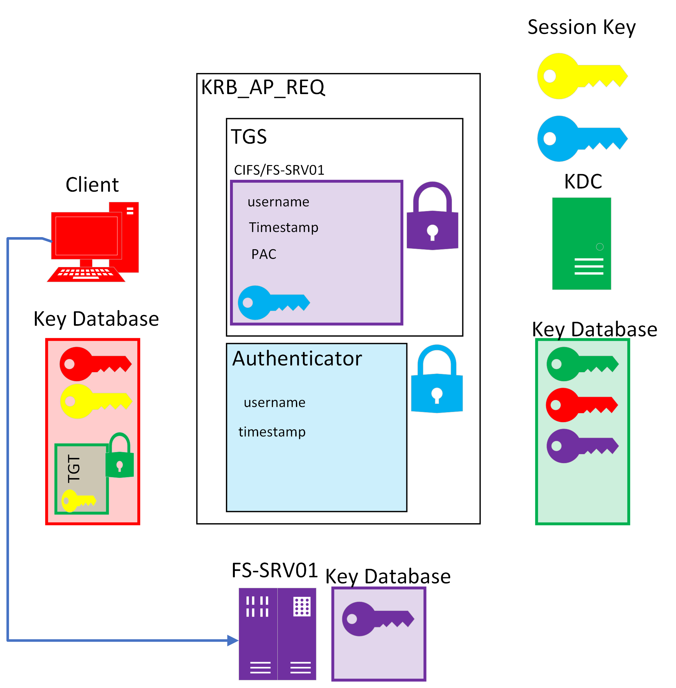
KRB_AP_REQ
Notes:
The AP_REQ is essentially going to forward the TGS ticket to the server hosting the service and the serice will check its permission and determine if the client can use its resources. I'll be skipping the AP_REP diagram breakdown.

Slide 19
Some famous Kerberos attacks
AS-REP Roasting (PrivEsc)
AS-REQ Spamming / Bruteforce (Enumeration/PrivEsc)
Kerberoasting (PrivEsc) <===
Golden Ticket (Persistance) <===
Silver Ticket (Persistance) <===
Delegation Attacks (PrivEsc)
Notes:
AS-REQ is useful for user enumeration and bruteforcing, AS-REP Roasting is an attack against Kerberos for user accounts that do not require pre authentication.
Kerberoasting is an attack on the TGS part of the process.

Slide 20
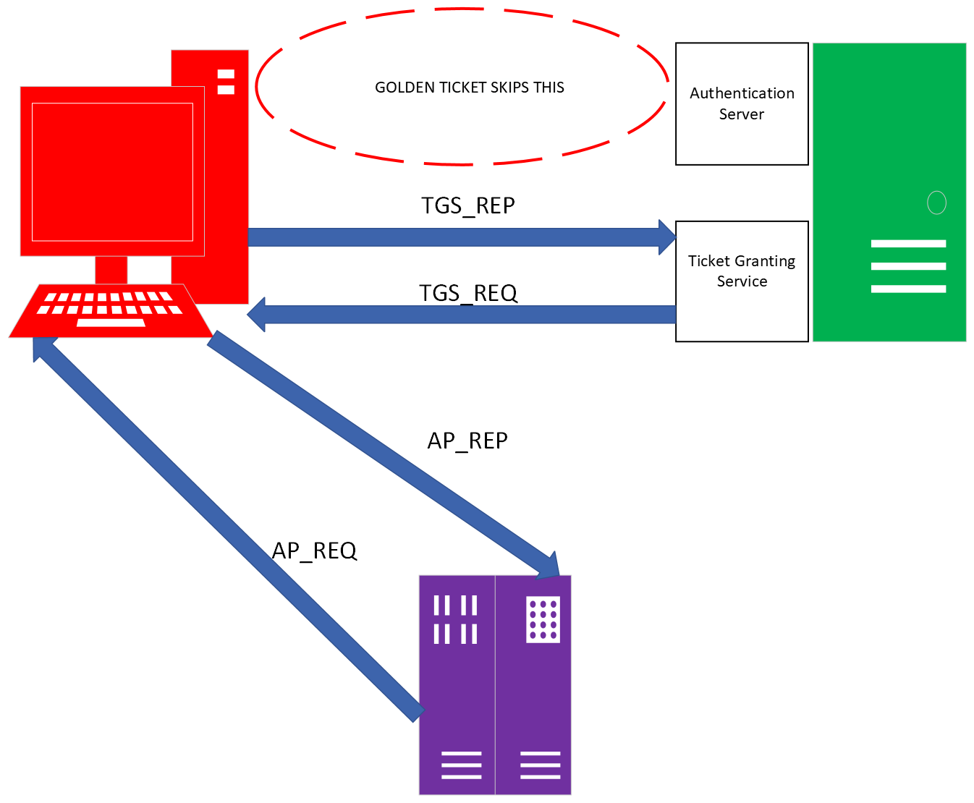
Golden Ticket
Event ID: 4624 Logon
Event ID: 4772 Priv'd Logon
Event ID: 4769 TGT Request
Event ID: 4769 TGS Request
Notes:
Leaves some useful logs on the Domain contoller
Attack requirments:
Fully qualified domain name (FQDN) of the domain.
Security identifier (SID) of the domain.
KRBTGT password hash. <======= Hardest part
Username of the account they want to impersonate

Slide 21
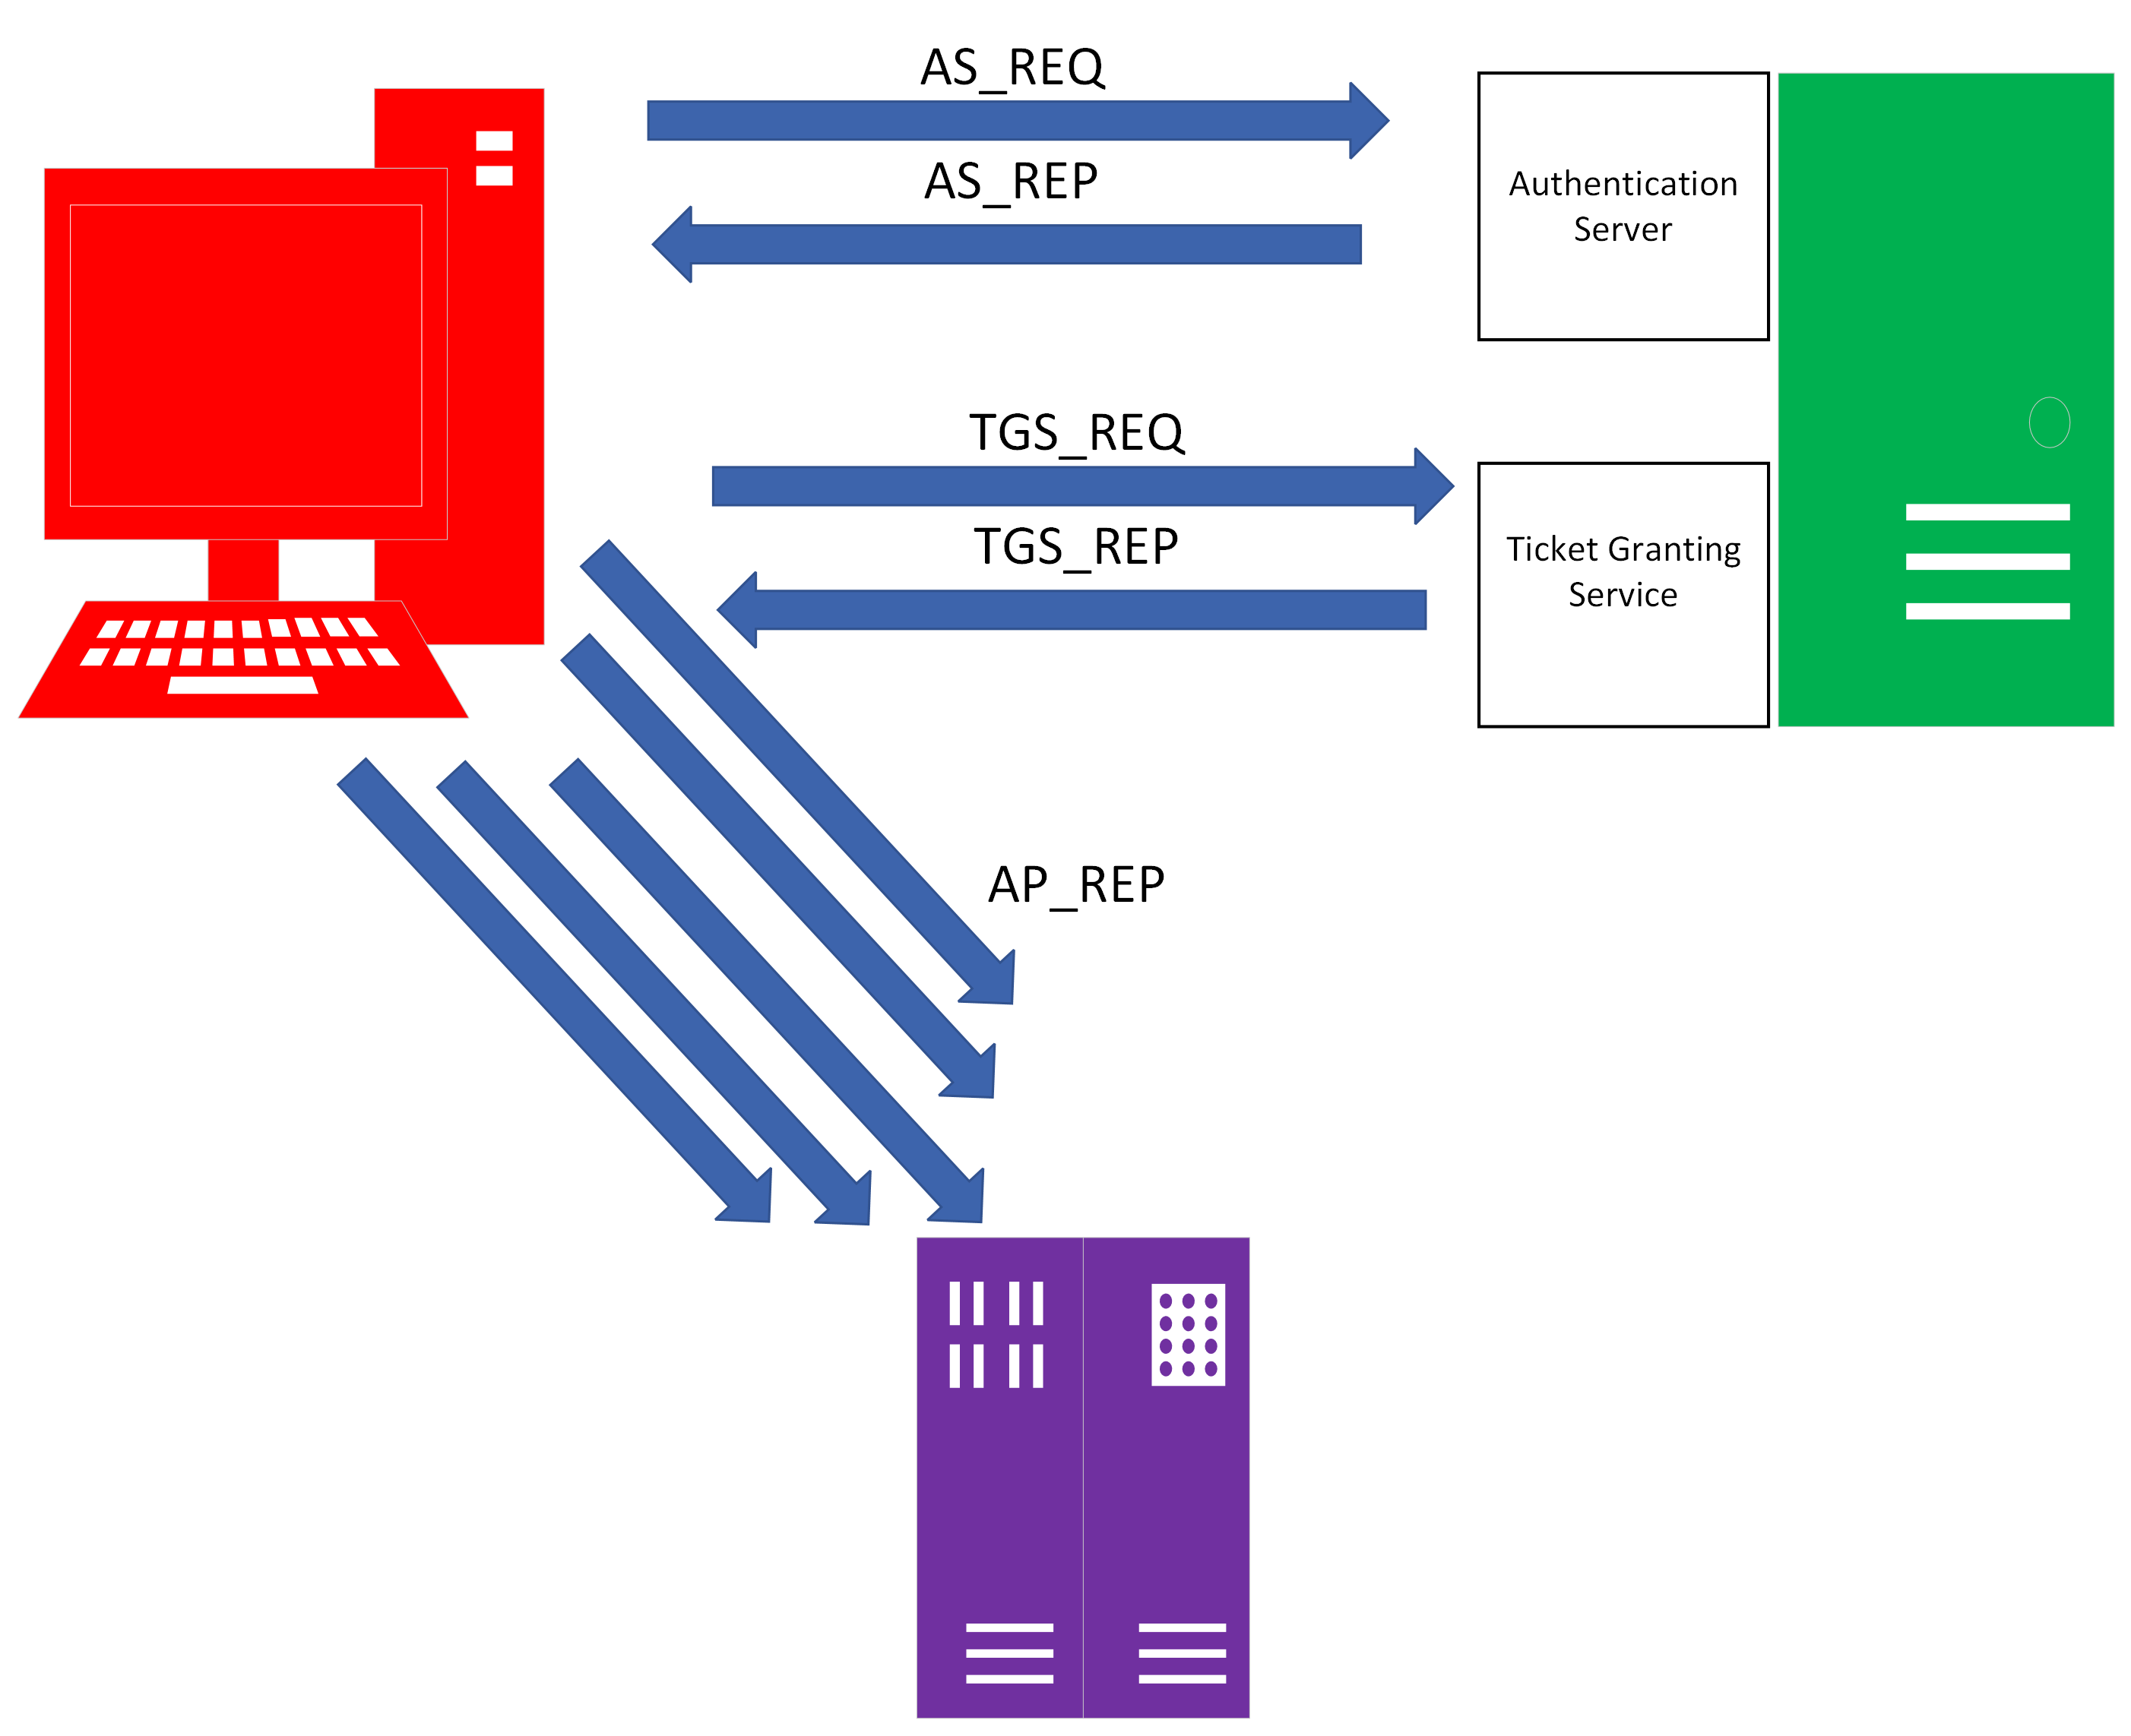
Kerberoasting
AS_REQ
AS_REP
Notes:
Domain controler will have high TGS logs
Attack requirements: A valid set of credentials for a domain account (because you need a valid TGT)

Slide 22
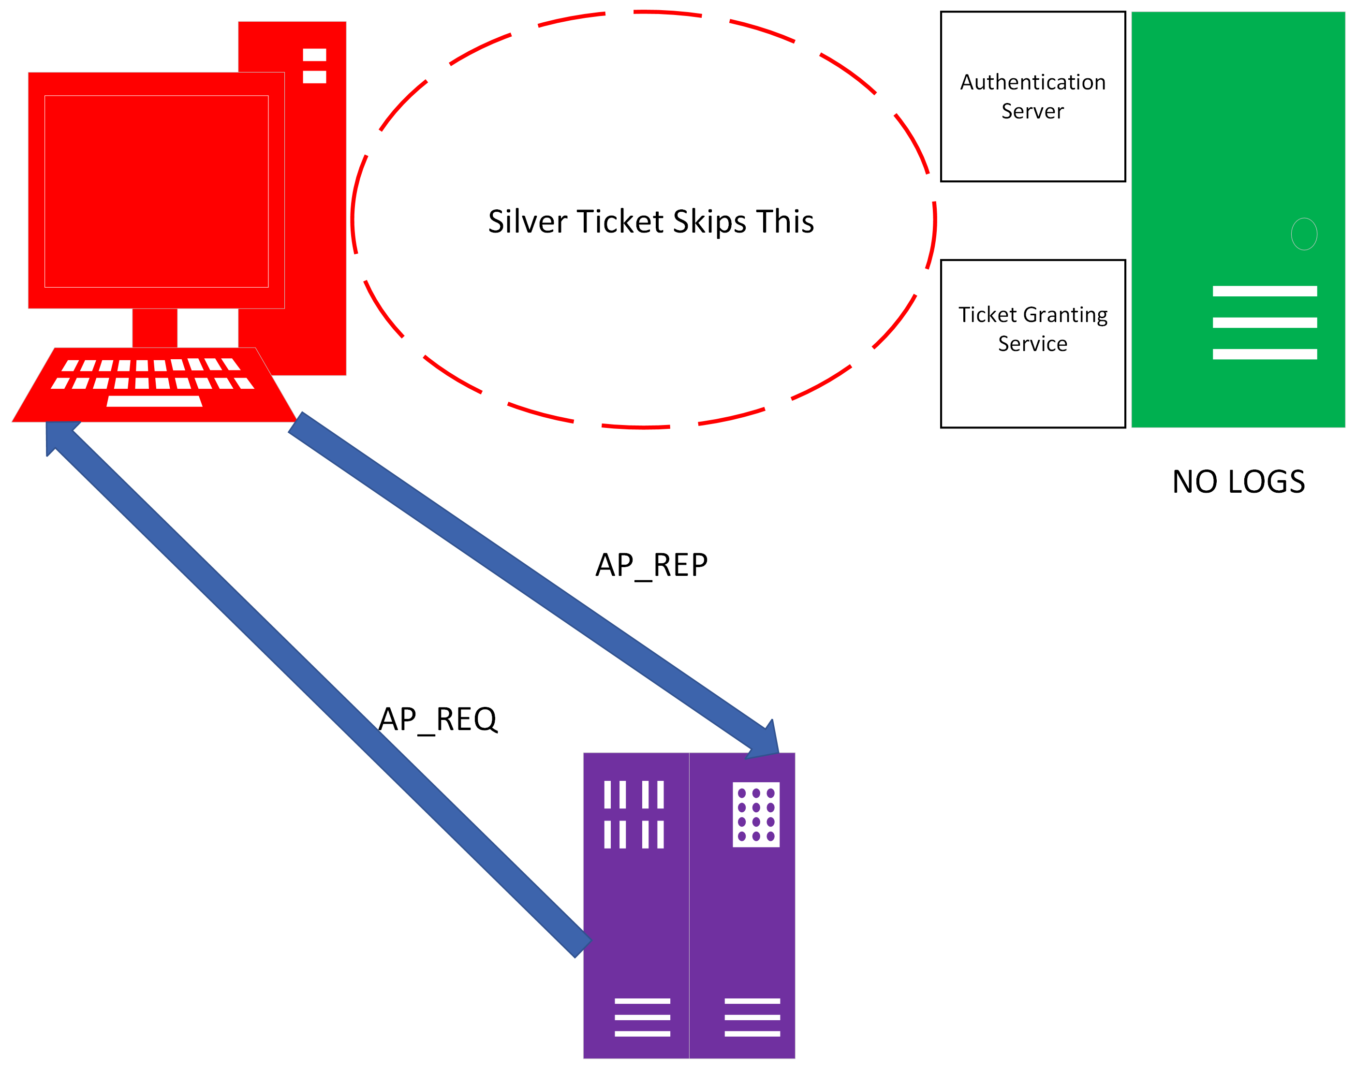
Silver Ticket
Notes:
You are able to skip talking to the AS and the TGS because you already have the krbtgt secret key and any service secret key you want to impersonate.
Useful for attackers because it is harder to detect from a logging perspective.

Slide 23
Writing Detections

Slide 24
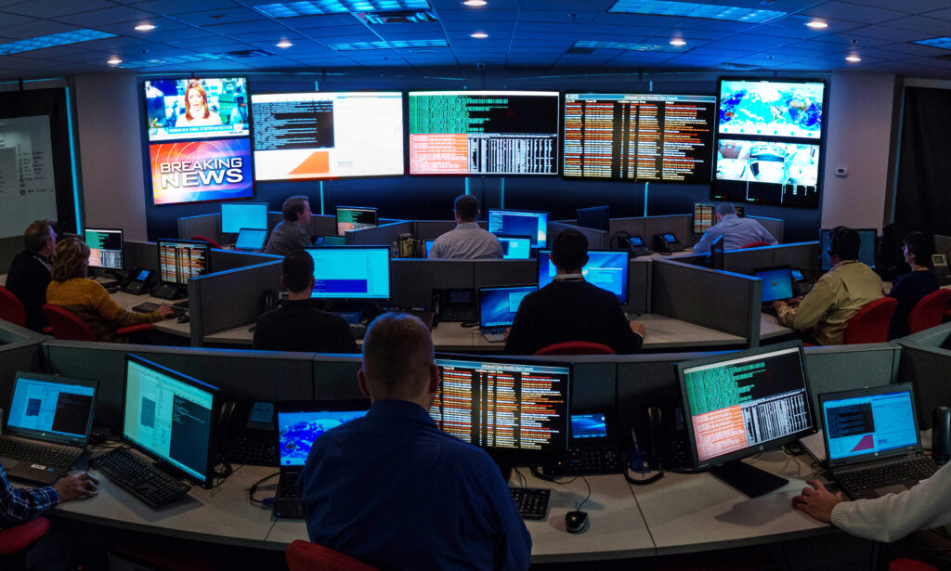

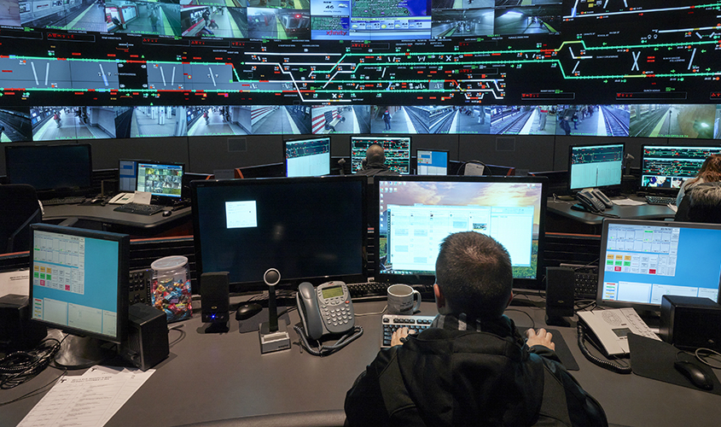

Slide 25
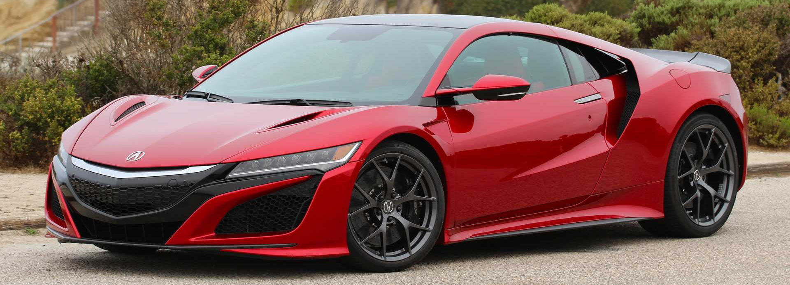
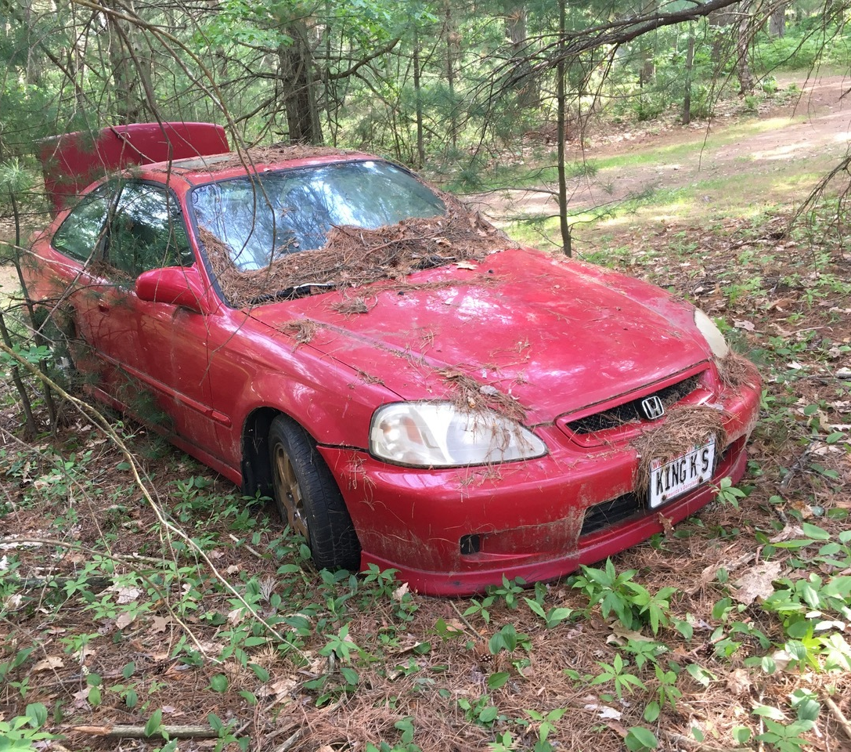
BrokeBoyz Cyber Kit™
We may not have the resources to create static IOC's
Let's make some Behavior detections

Slide 26

BrokeBoyz Cyber Kit™: Catching Golden Tickets
Behaviors we will focus on:
Missing Auth Flow
LOW PRIVs making 4672
Notes:
I bundled these two detections into one script because we ran out of time.

Slide 27
Catching Golden Tickets: Missing Auth Flow
Event
4624 Logon
Event
4672 Special Logon (HIGH PRIV ACCOUNTS)
Event
4768 TGT request
Event
4769 TGS request

Slide 28
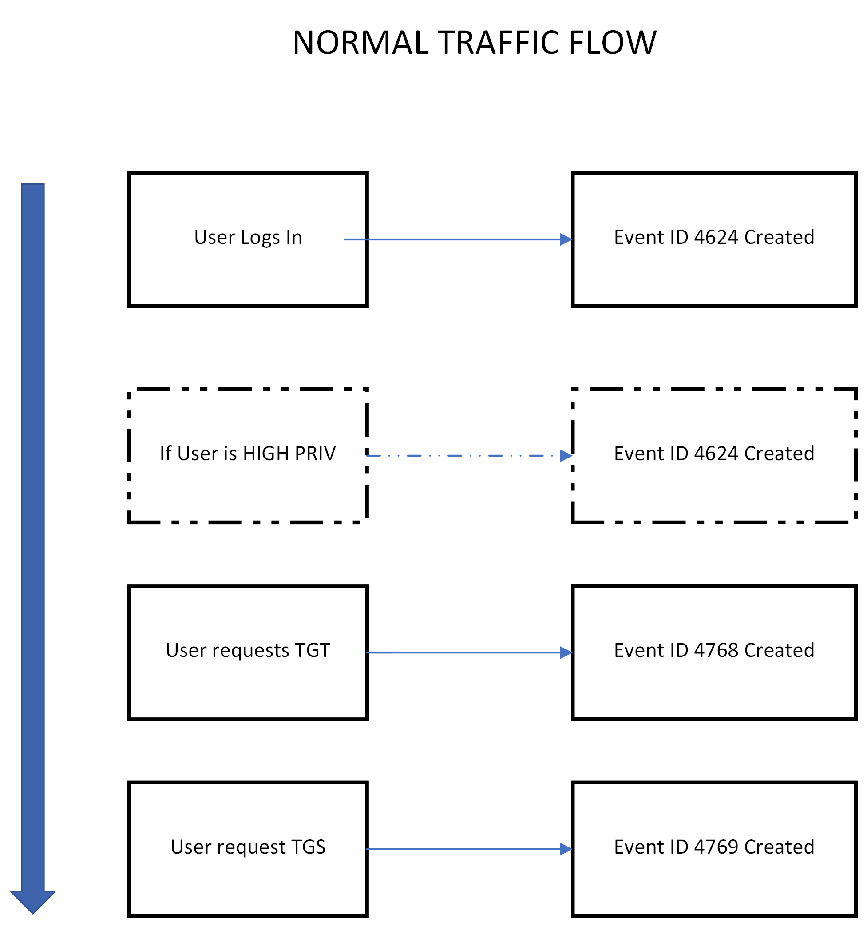
Normal Event Log Artifacts

Slide 29
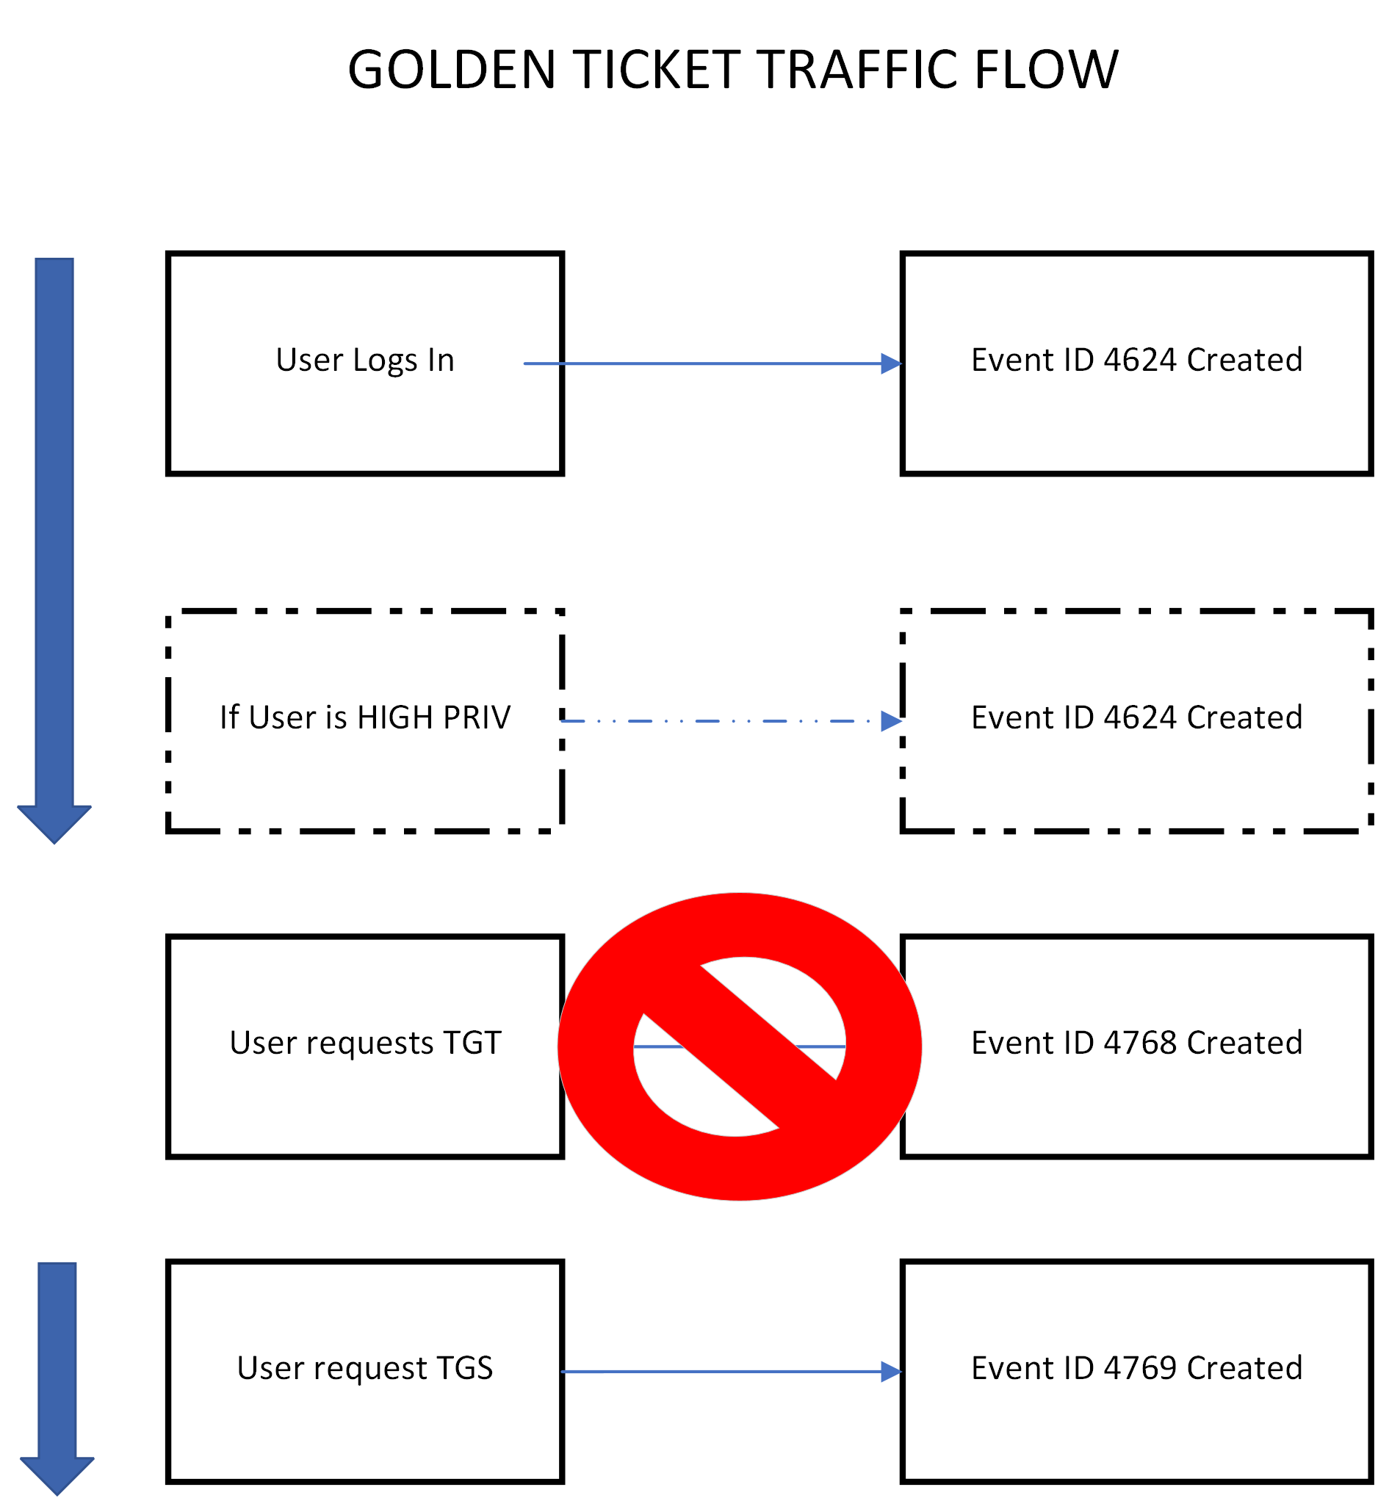
G Ticket Event Log Artifacts

Slide 30
BrokeBoyz Cyber Kit™: Catching Kerberoasting
Behaviors we will focus on:
Encryption downgrade ( Default AES-256 Server 2016+ )
HIGH amounts of TGS request
Chad from Sales making TGS request to prod SQL SRVs
Notes:
Was not able to write a detection for Chads lateral movement

Slide 31
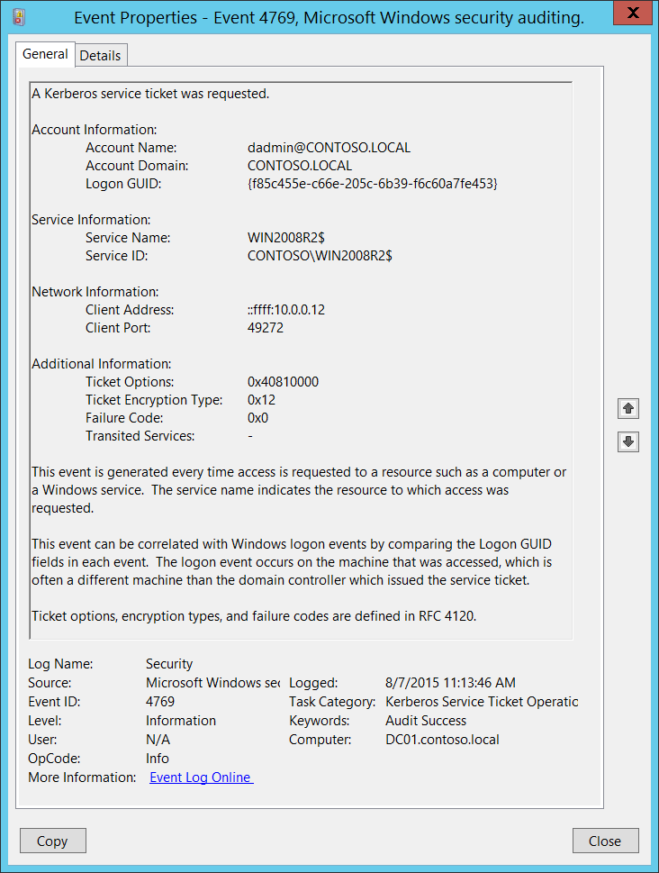
Catching Kerberoasting: Encryption Downgrade

Slide 32
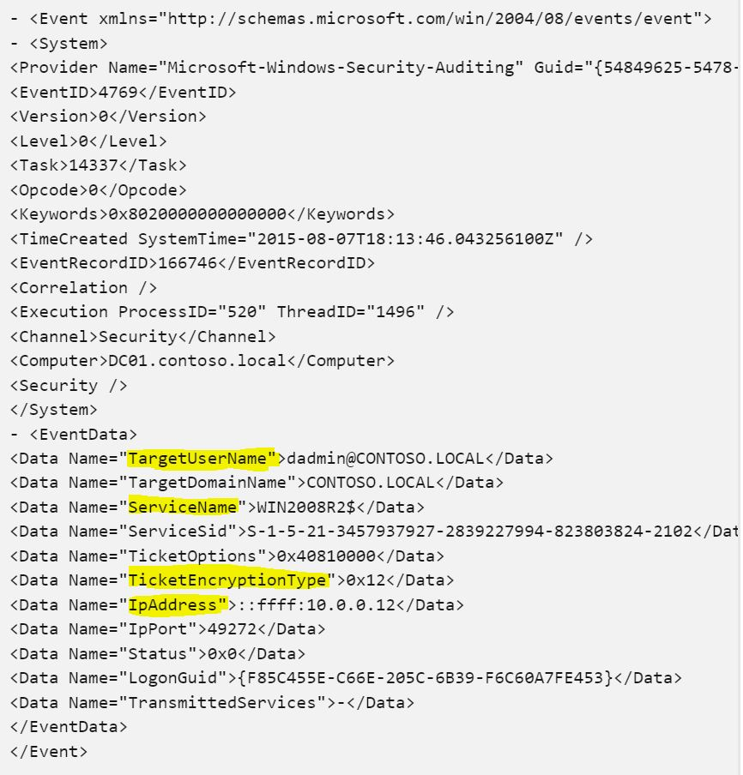

Slide 33
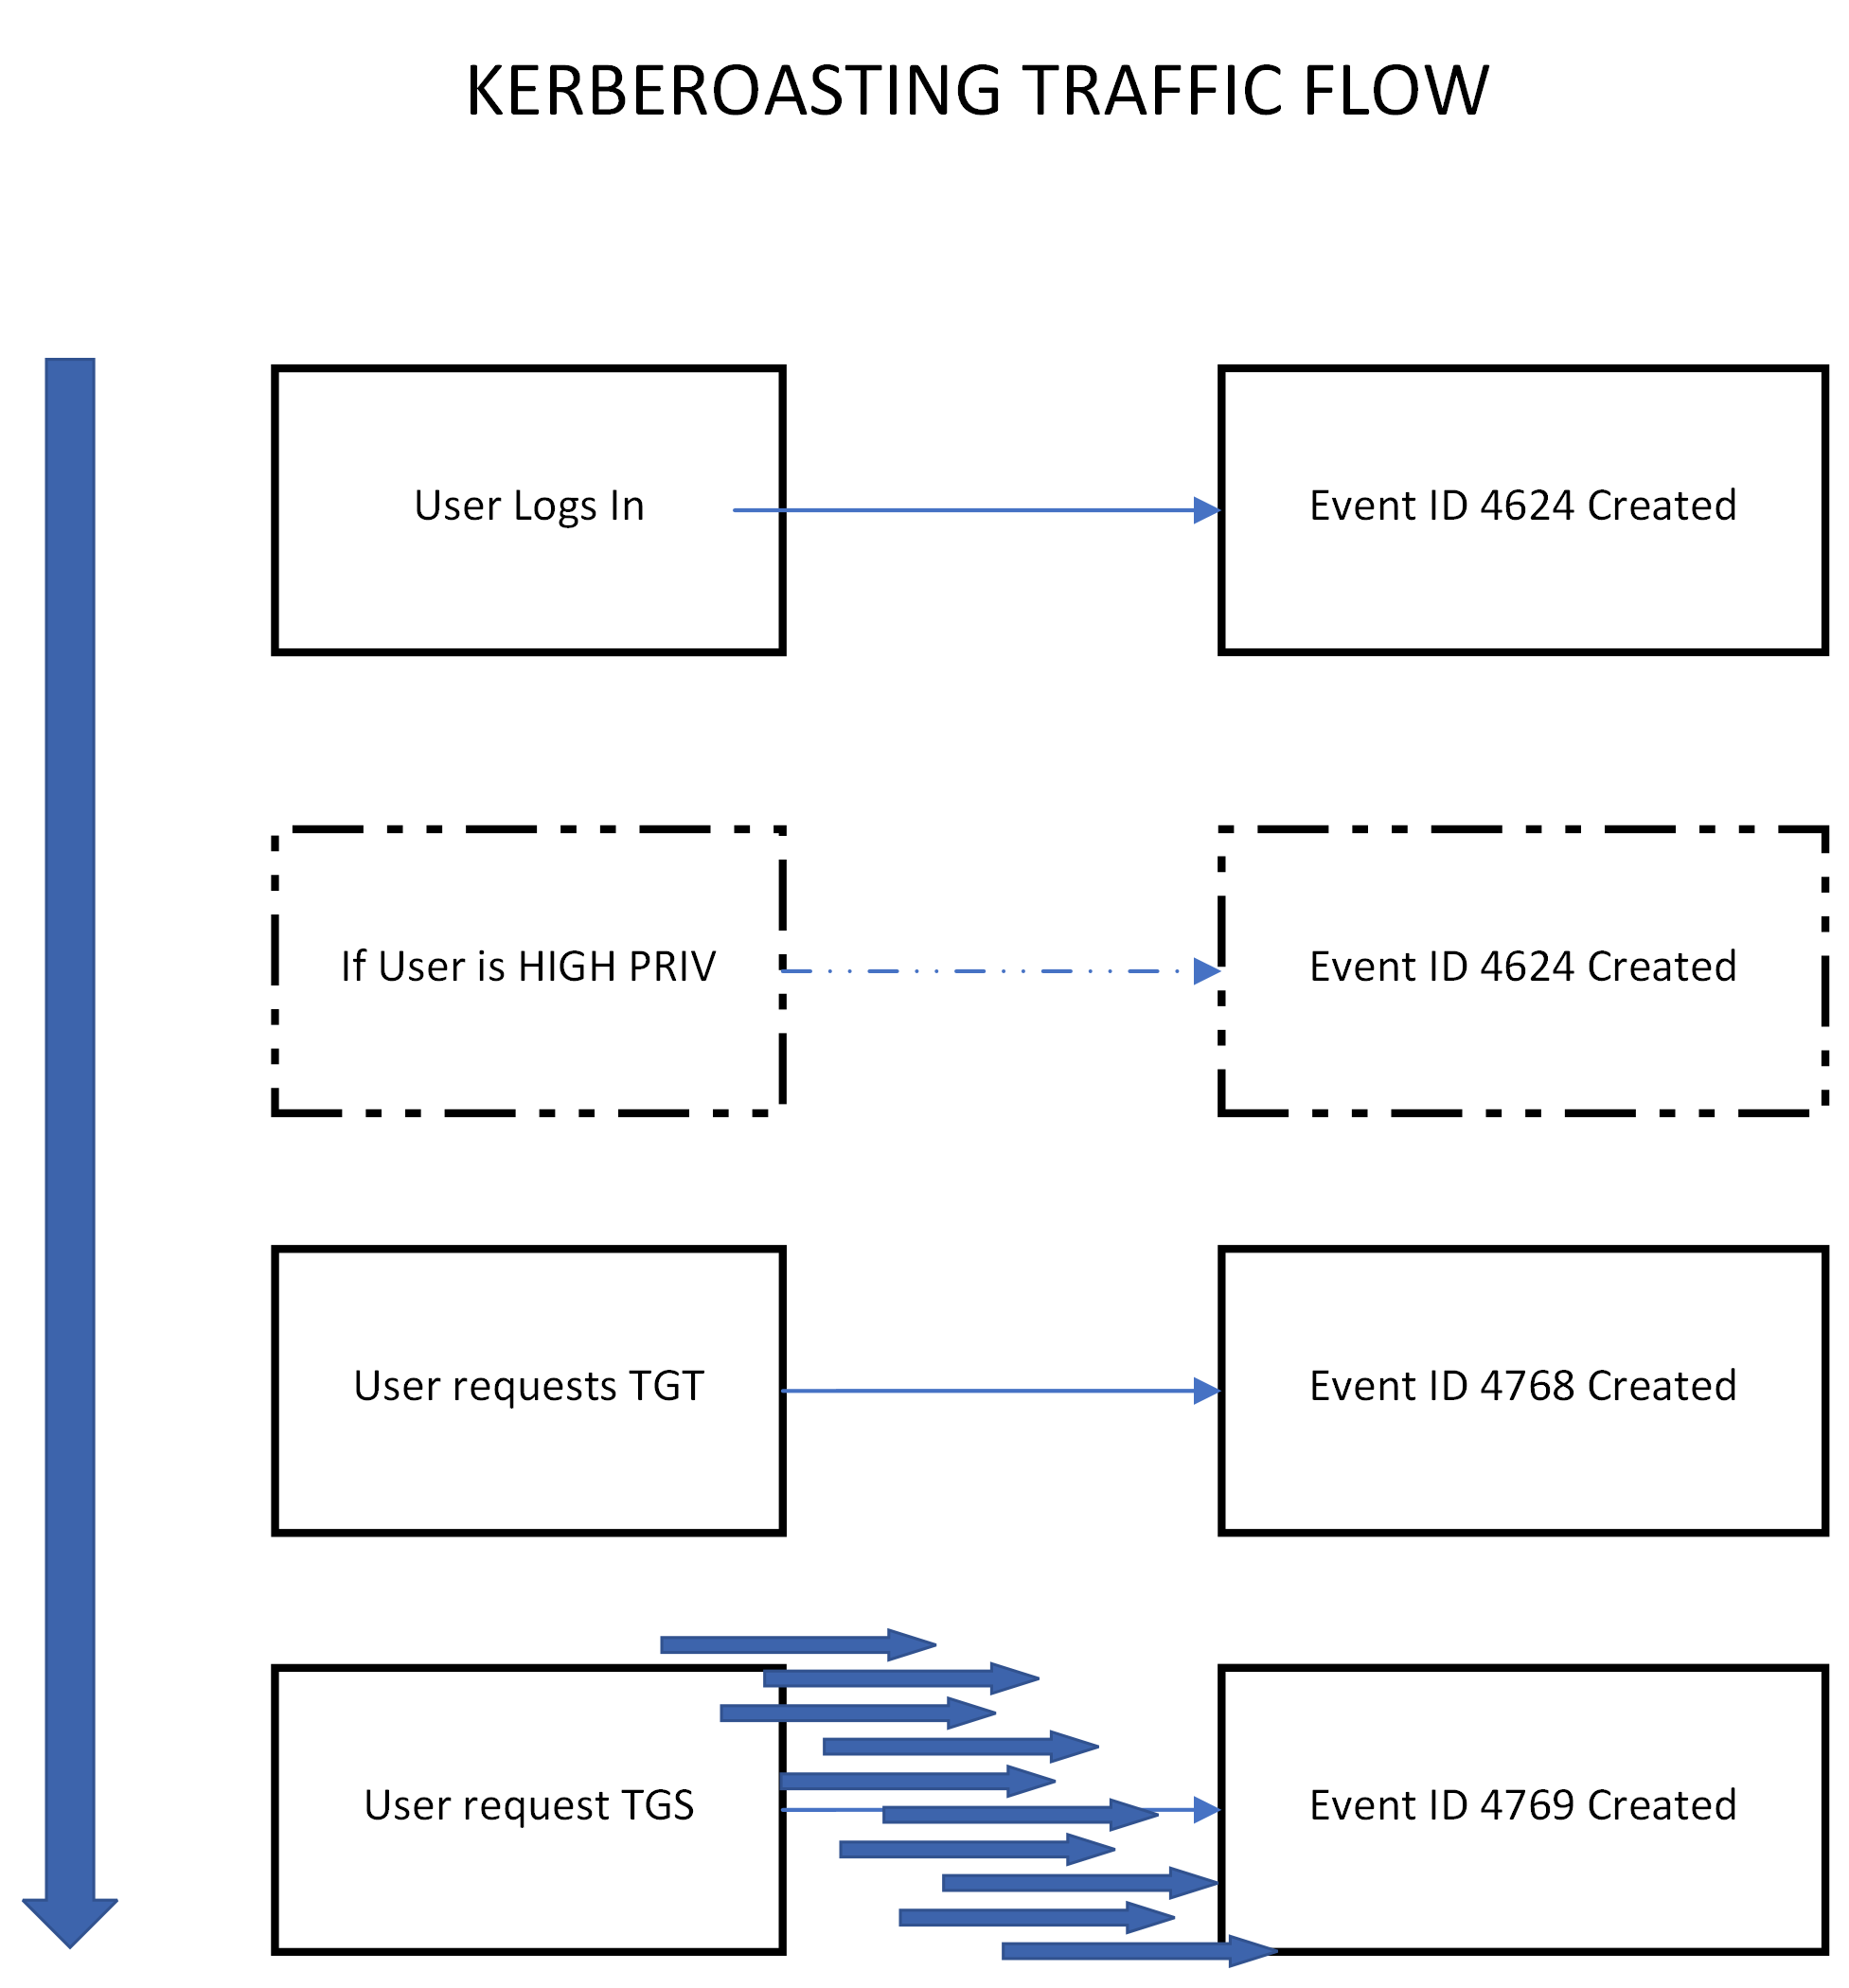
Catching Kerberoasting: High TGS Request

Slide 34
Big thanks to
Johannes Pangrestu: Johannes Pangrestu, MBA | LinkedIn
Daniel Jimenez: Daniel López Jiménez | LinkedIn

